Slide 1
Modelleren en Systeemontwerp
Refactoring

Slide 2

This lecture
What is refactoring?
... or how to deal with the horrible code your colleagues have created
... or how to deal with the horrible code you created yourself

Slide 3
Applying design patterns
So far, we have often considered the situation where we can start designing new software from scratch
In practice, this is uncommon – you usually have to develop with existing systems
Does that mean that design patterns are not useful in practice?

Slide 4
Iteratively improving designs
You can still apply design patterns to existing software:
to improve the internal structure
to facilitate testing
to pave the way for new features

Slide 5

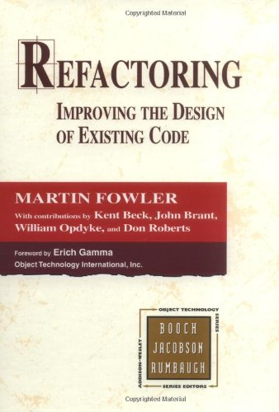
Refactoring
Refactoring (noun): a change made to the internal structure of software to make it easier to understand and cheaper to modify without changing its observable behavior.

Slide 6
Case study: refactoring a movie rental system
Let us have a look at a refactoring case study taken from the first chapter of Fowler’s book
Starting with some poorly designed code, we will refactor this step by step

Slide 7
Starting situation

Slide 8
Initial classes
The Movie class defines three price codes as integer constants: CHILDREN = 0 STANDARD = 1 NEW = 2
The Rental class tracks the number of days a particular movie has been rented
Finally, the Customer class records a list of Rentals

Slide 9
foreach (Rental v in rentals) {
v_price = 0;
switch (v.getMovie().getPriceCode()) {
case Movie.STANDARD :
v_price = 3 euro * v.daysRented; break;
case Movie.NEW :
v_price = 5 euro * v.daysRented; break;
case Movie.CHILDREN :
v_price = 2 euro * v.daysRented; break;
}
totPrice += v_price;
pts++;
if (v.getMovie().getPriceCode() == Movie.NEW)
pts++;
}
Question: What is wrong with this code?

Slide 10
Weak cohesion
This fragment is computing the price of the rental and the customer points earned . . .
. . . so it deals with two responsibilities at the same time!
We will introduce a separate method for dealing with the details of rental prices

Slide 11
Extract method
foreach (Rental v in rentals) {
v_price = calculatePrice(v);
totPrice += v_price;
pts++;
if (v.getMovie().getPriceCode() == Movie.NEW) {
pts++;
}
…
}
... but we still are annoyed by the details of calculating the earned points

Slide 12
Extract method
foreach (Rental v in rentals) {
v_price = calculatePrice(v);
totPrice += v_price;
pts = calculateEarnedPoints(v, pts);
…
Note that we have to pass along enough information to compute the new running total of earned points
In this example, we pass both the video v and current total points pts to calculateEarnedPoints
We also notice that v_price is superfluous

Slide 13
Extract method
foreach (Rental v in rentals) {
totPrice += calculatePrice(v);
pts = calculateEarnedPoints(v, pts);
…
Ah, that looks better!
But should both these computations really be in the same loop?

Slide 14
Overloading loops
But should both these computations really be in the same loop?
Probably old school programmer habits…
Let us do two calculations in the same loop
That saves processing time!
Yeah, let us save 0.02 ms processing time at the expense of losing cohesion . . .
Wouldn’t it be better to define separate getCharge() and getRenterPoints() methods?

Slide 15
Getting rid of switches
switch (v.getMovie().getPriceCode()) {
case Movie.STANDARD :
v_price = 3 euro * v.daysRented; break;
case Movie.NEW :
v_price = 5 euro * v.daysRented; break;
case Movie.CHILDREN :
v_price = 2 euro * v.daysRented; break;
}
Switches may cause maintenance headaches!

Slide 16
switch to strategy
Be sure that switches appear at the right place
Often it is an indication to apply the Strategy pattern
Separate the choice of an algorithm from the implementation of the algorithm

Slide 17
Refactoring safely
It is all too easy to make mistakes or introduce bugs during refactoring
Big refactors can be really complex
What best practices can help refactor effectively?

Slide 18
Refactoring
Do not start refactoring complex code unless you have a good test suite – how else will you know that refactoring hasn’t changed a program’s behavior?
Refactor in the smallest possible steps
Be sure that you can take a step back: version management
Test after every step – catching bugs early will make your life a lot easier

Slide 19
Why refactor?
Refactoring may be necessary to improve the software’s design – eliminating duplicate code, for example
Refactoring makes software easier to understand
Refactoring makes software easier to adapt
Refactoring makes software easier to test
Refactoring helps spotting bugs
Refactoring supports faster programming

Slide 20
When should you refactor?
Rule of three
The first time you write something, just write it
The second time, wince at duplicate code
The third time, refactor
Refactor when you add a new feature
Refactor when you fix a bug
Refactor when you do a code review
There is no golden rule

Slide 21
Bad code smells
Fowler identifies a list of bad code smells
These are not bugs, but symptoms in the source code that may indicate bad design, or the need for refactoring
Whenever you are programming, or doing a code review, knowing about bad code smells can help identify problems, before they become hard to fix
Let us cover a few here and give some examples

Slide 22
Bad code smell?
temp_c1 = (5/9)*(temp_f1-32);
temp_c2 = (5/9)*(temp_f2-32);
temp_c3 = (5/9)*(temp_f3-32);
avg_temp_c = (temp_c1 + temp_c2 + temp_c3) / 3;
Remedy: introduce a method

Slide 23
Long method (with vague name)
int doIt() {
...
// 500 lines of weakly cohesive gibberish
...
}
This usually indicates one method is doing too much
Remedy: split into smaller, more cohesive methods

Slide 24
Large class (with vague name)
public class Utils {
...
// 1000 weakly cohesive methods
...
This indicates a class is doing too much
Remedy: split into smaller, more cohesive, loosely coupled classes

Slide 25
Too many parameters
Result computeResult(DatabaseConnection db,
UserQuery uq, ReceiptPrinter r, UserName name,
CustomerReceiptHandler crh, SalesRegister register,
CurrencyConverter cc, MovieDatabase imdb,
CustomerIdNumber cin, ...)
This usually indicates that a method is trying to do too much
Remedy: split into smaller, more cohesive, methods

Slide 26
Anti-pattern: shotgun surgery
Suppose you want to make a change, for example, introduce a new kind of movie to the video store case study
But to do this, you need to update the existing software in many different places – this is called shotgun surgery
If this is not an unusual modification, the software is poorly designed!

Slide 27
Divergent change
Suppose we have our Shapes in the CAD/CAM software again
Over time, we add colors to our Shapes, methods for modifying colors (increasing transparency, brightness, etc.)
But we also add information about borders – maybe sometimes the border should be dashed or dotted
As time goes on, each individual Shape object is less and less cohesive
Remedy: introduce separate classes to handle colors and borders
Smells like Strategy

Slide 28
Bad smell?
switch (v.getMovie().getPriceCode()) {
case Movie.STANDARD :
v_price = 3 euro * v.daysRented; break;
case Movie.NEW :
v_price = 5 euro * v.daysRented; break;
case Movie.CHILDREN : v_price = 2 euro * v.daysRented; break;
}
The responsibility for this computation is in the wrong place
Remedy: Add a method to the superclass (or introduce a Strategy)

Slide 29
Comments
Comments are a Good Thing, right?
This should be a sweet smell, not a bad smell. . .

Slide 30
Comments
But if a method or objects needs lots of comments, maybe these comments are masking bad design.
public void compute() {
// This is a really complicated method
// that shouldn’t be changed.
// It took me a long time to get it right,
// so DO NOT TOUCH IT!!!!!
This is an excellent candidate for refactoring!

Slide 31
Bad names
Excessively long identifiers: in particular, the use of naming conventions to provide disambiguation that should be implicit in the software architecture
Excessively long identifiers may indicate an overload of responsibilities
Excessively short identifiers: the name of a variable should reflect its function unless the function is obvious.
z = h.getX() * i.getY() + k.getQ();
Excessive use of literals:
x = 3.14 * 12 + 13 / 256;

Slide 32
Fowler’s refactoring catalogue
Every refactoring is described in a uniform format:
The refactoring’s name
A summary of what the refactoring does;
The motivation explaining when to apply the refactoring (and when not to apply it)
The mechanics giving a recipe of how to apply a refactoring
Finally, examples illustrating a refactoring

Slide 33
Example: inline temp
Summary: You have a temporary variable that is assigned to once with a simple expression, and the temp is getting in the way of other refactorings
Replace all references to that temp with the expression
double basePrice = anOrder.basePrice();
return (basePrice > 1000);
This becomes:
return (anOrder.basePrice() > 1000);

Slide 34
Example: inline temp
Mechanics
Declare the temp as a constant and compile. This tests that it is really only assigned once
Find all references to the temp and replace them with the right-hand side of the assignment
Compile and test after each change
Remove the declaration of the assignment of the temp
Compile and test

Slide 35
Example: inline temp
Motivation
(fragment from Fowler)
The only time Inline Temp is used on its own is if you find a temp that is assigned the value of a method call. Often the temp isn’t doing any harm and you can leave it there. If the temp is getting in the way of other refactorings, such as Extract Method, it’s time to inline it.

Slide 36
Inverses
Many refactorings have a reverse refactoring as well. For example, Introduce explaining variable is the opposite of Inline temp
// base price - quantity discount + shipping
return quantity * itemPrice
- Math.max(0, quantity - 500) * itemPrice * 0.05
+ Math.min(quantity * itemPrice * 0.1, 100);
Becomes:
double basePrice = quantity * itemPrice;
double discount = ...
double shippingFee = ...
return basePrice - discount + shippingFee;

Slide 37
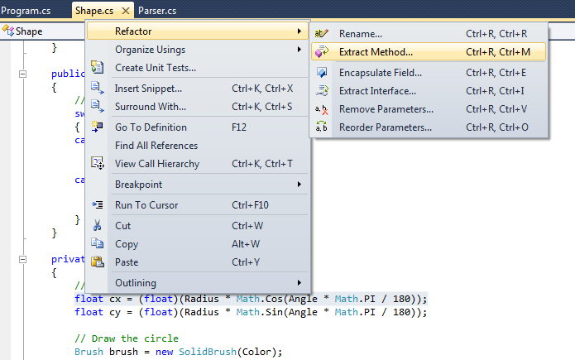
Refactoring in an ide

Slide 38
Refactoring overview
Finally, let us have a look at a quick overview of some other refactorings that Fowler identifies:
Introduce parameter object
Moving methods, fields, or attributes
Splitting classes
Hiding delegates
You might argue that these refactorings are on the level of design rather than code

Slide 39
Introduce parameter object
Methods with too many parameters are hard to call:
processCustomerOnDate(date, isOpen, age, hasDiscountCard, customerId)
Perhaps it is better to reorganize this into:
processCustomerOnDate(dateProfile, customerProfile)
and introduce new objects dateProfile and customerProfile storing the associated data

Slide 40
Moving code
Perhaps this class is becoming too weakly cohesive…

Slide 41
Moving code
This is an example of the Extract class refactoring

Slide 42
Pull up
If all subclasses support the discount method, shouldn’t this be defined in the superclass?

Slide 43
Pull up
This is the Pull-up refactoring

Slide 44
Pull down
Why should you define a dummy implementation for the drink method of the Apple class?

Slide 45
Pull down
It’s better to apply the Pull-down refactoring

Slide 46
Refactorings in all shapes and sizes
There are lots of other kinds of refactorings:
Extract a common superclass when several classes share the same attributes and methods
Introduce a new subclass of ClassX, to distinguish a specific kind of ClassX
...

Slide 47
Refactoring - lessons
Refactoring helps keep code clean
Aim for self-documenting code:
choose meaningful names
lift complex computations into separate methods
keep control flow simple
...
When refactoring, take small steps and test all the time

